Slide 1



Özkütle Deneyi
Demonstrating Reduced-Voltage FPGA-Based Neural Network Acceleration for Power-Efficiency
Erhan Baturay Onural
TOBB ETU
Ismail Emir Yuksel
TOBB ETU
Behzad Salami
BSC
30th International Conference on Field-Programmable Logic and Applications (FPL), 2nd September 2020

Slide 2
Outline
Executive Summary
Motivational Background
Methodology
Power Breakdown
Demo Methodology
Observations
  Voltage Behaviour
  Power and Reliability Trade-off
Bonus: Frequency Underscaling

Slide 3
Executive Summary

Slide 4
Executive Summary
Goal: Achieve power efficiency by undervolting on FPGA based neural network accelerators.

Slide 5
Executive Summary
Goal: Achieve power efficiency by undervolting on FPGA based neural network accelerators.
Supply voltage below nominal level.

Slide 6
Executive Summary
Goal: Achieve power efficiency by undervolting on FPGA based neural network accelerators.
Supply voltage below nominal level.
Large guardband to ensure the correct operation under the worst-case environment. (~ %33 of the nominal supply voltage)

Slide 7
Executive Summary
Goal: Achieve power efficiency by undervolting on FPGA based neural network accelerators.
Supply voltage below nominal level.
Large guardband to ensure the correct operation under the worst-case environment. (~ %33 of the nominal supply voltage)

Slide 8
Executive Summary
Goal: Achieve power efficiency by undervolting on FPGA based neural network accelerators.
Supply voltage below nominal level.
Large guardband to ensure the correct operation under the worst-case environment. (~ %33 of the nominal supply voltage)
Evaluation Setup: 5 CNN application and 3 Xilinx Ultrascale⁺ ZCU102 boards.

Slide 9
Executive Summary
Goal: Achieve power efficiency by undervolting on FPGA based neural network accelerators.
Supply voltage below nominal level.
Large guardband to ensure the correct operation under the worst-case environment. (~ %33 of the nominal supply voltage)
Evaluation Setup: 5 CNN application and 3 Xilinx Ultrascale⁺ ZCU102 boards.
Main Results: >3x power efficiency gain.

Slide 10
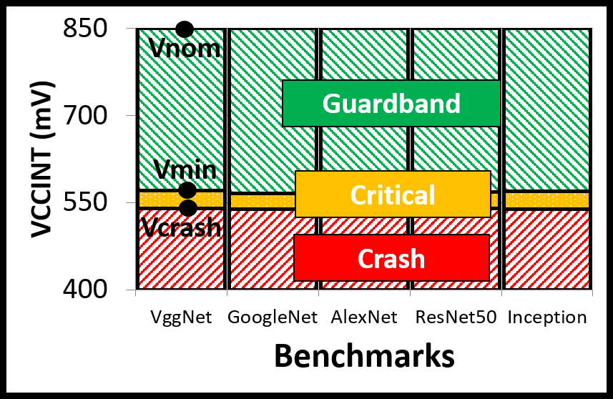
Executive Summary

Slide 11
Executive Summary
Observation: It is possible to achieve significant power savings by eliminating the large safe guardband.

Slide 12
Executive Summary
Observation: It is possible to achieve significant power savings by eliminating the large safe guardband.
Observation: It is still possible to achieve further power savings by eliminating the narrow critical region. Reliability issues start to occur.

Slide 13
Executive Summary
Observation: It is possible to achieve significant power savings by eliminating the large safe guardband.
Observation: It is still possible to achieve further power savings by eliminating the narrow critical region. Reliability issues start to occur.
Observation: The FPGA stops operating under certain voltage level.

Slide 14
Motivational Background

Slide 15
Motivational Background
Neural Net. applications are getting more complex and power hungry.

Slide 16
Motivational Background
Neural Net. applications are getting more complex and power hungry.
FPGAs becoming popular. (Amazon AWS, Intel Acceleration Hub, MS Brainwave)

Slide 17
Motivational Background
Neural Net. applications are getting more complex and power hungry.
FPGAs becoming popular. (Amazon AWS, Intel Acceleration Hub, MS Brainwave)
Higher throughput than GPUs.
Higher flexibility than ASICs.

Slide 18
Motivational Background
Neural Net. applications are getting more complex and power hungry.
FPGAs becoming popular. (Amazon AWS, Intel Acceleration Hub, MS Brainwave)
Higher throughput than GPUs.
Higher flexibility than ASICs.
FPGAs are less power efficient than equivalent ASICs.

Slide 19
Motivational Background
Neural Net. applications are getting more complex and power hungry.
FPGAs becoming popular. (Amazon AWS, Intel Acceleration Hub, MS Brainwave)
Higher throughput than GPUs.
Higher flexibility than ASICs.
FPGAs are less power efficient than equivalent ASICs.
Neural Net. applications are inherently tolerant to errors.

Slide 20
Motivational Background
Neural Net. applications are getting more complex and power hungry.
FPGAs becoming popular. (Amazon AWS, Intel Acceleration Hub, MS Brainwave)
Higher throughput than GPUs.
Higher flexibility than ASICs.
FPGAs are less power efficient than equivalent ASICs.
Neural Net. applications are inherently tolerant to errors.
Potential: Undervolting for FPGAs?

Slide 21
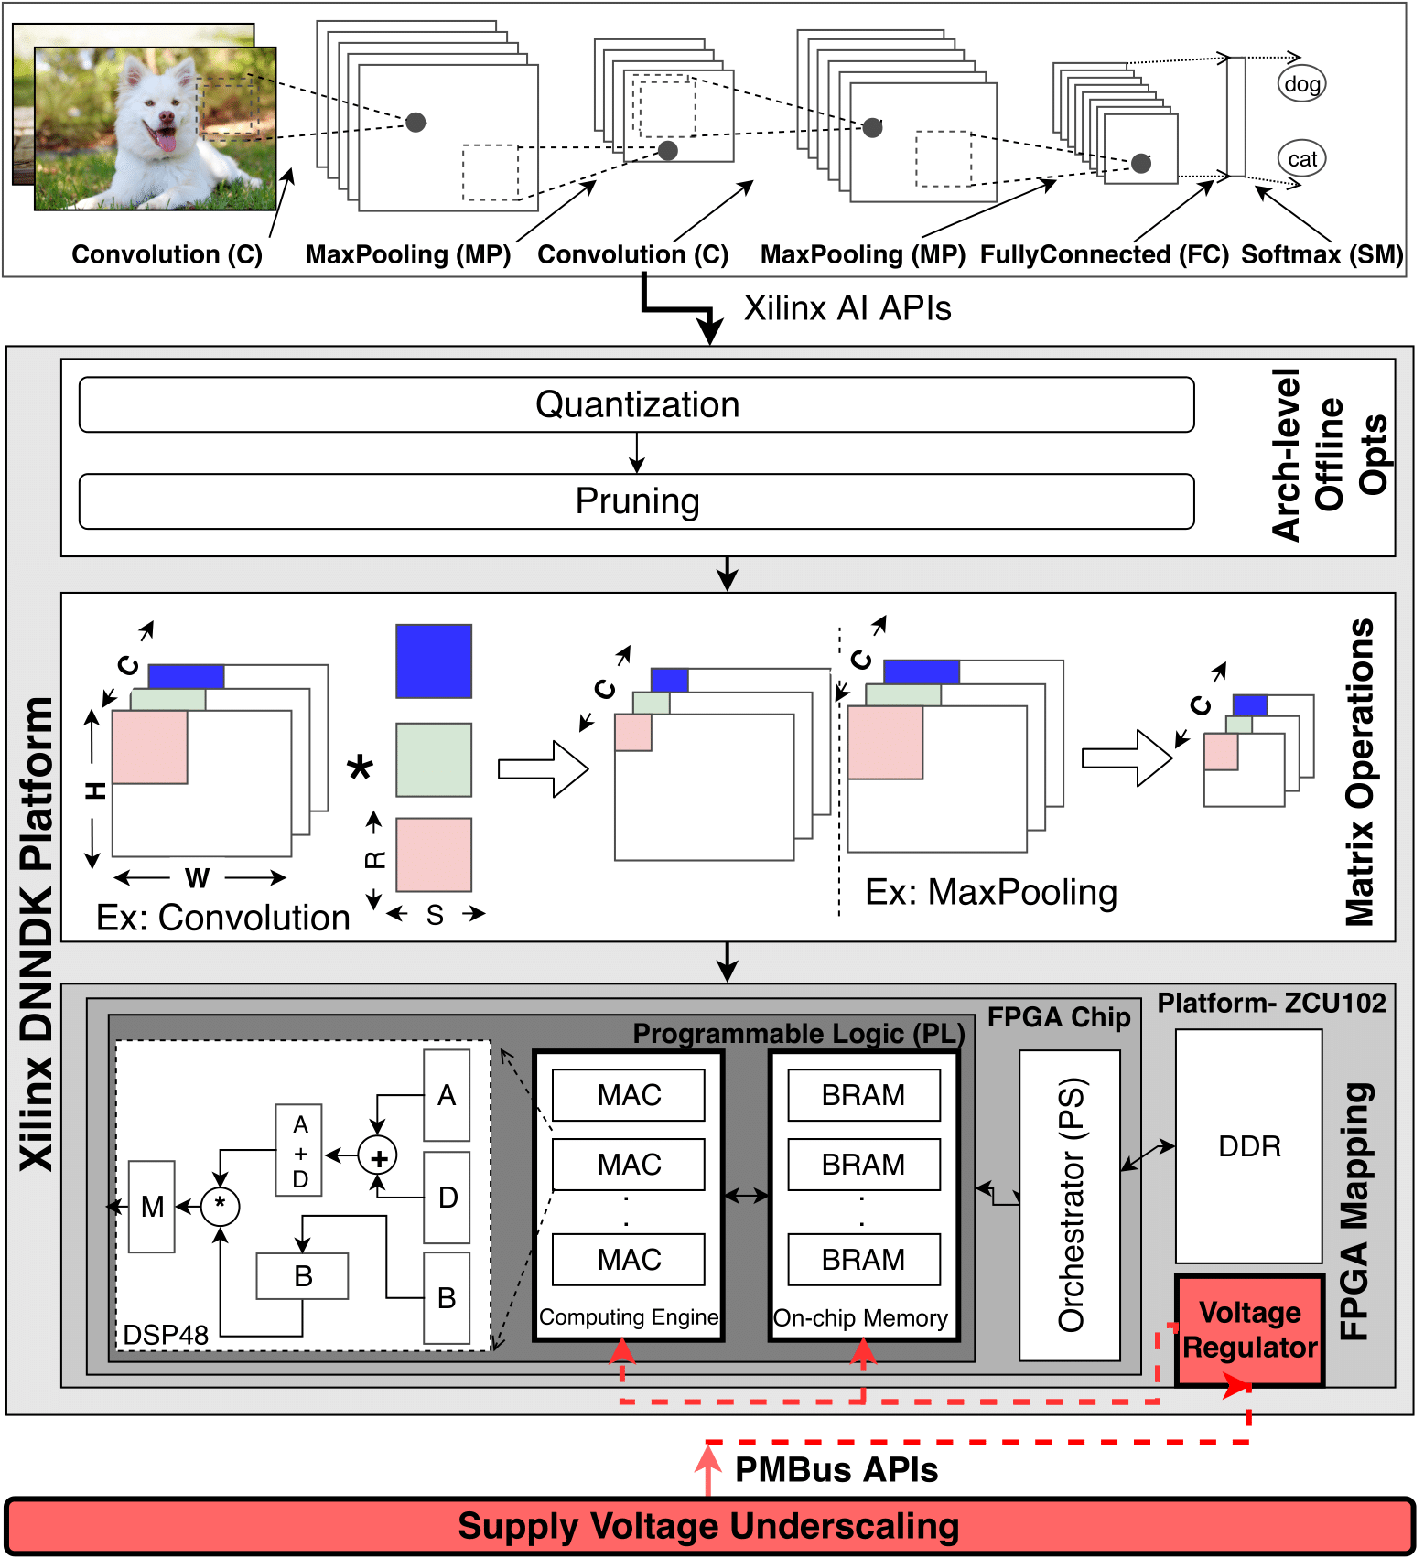
Methodology
5 CNN applications. (VGGNet, AlexNet, GoogleNet, ResNet, Inception)

Slide 22
Methodology
5 CNN applications. (VGGNet, AlexNet, GoogleNet, ResNet, Inception)
3 Xilinx Ultrascale⁺ ZCU102 boards.

Slide 23
Methodology
5 CNN applications. (VGGNet, AlexNet, GoogleNet, ResNet, Inception)
3 Xilinx Ultrascale⁺ ZCU102 boards.
Xilinx DNNDK to map CNN to FPGA.

Slide 24
Methodology
5 CNN applications. (VGGNet, AlexNet, GoogleNet, ResNet, Inception)
3 Xilinx Ultrascale⁺ ZCU102 boards.
Xilinx DNNDK to map CNN to FPGA.
Regulate voltage rails by PMBus API.

Slide 25
Methodology
5 CNN applications. (VGGNet, AlexNet, GoogleNet, ResNet, Inception)
3 Xilinx Ultrascale⁺ ZCU102 boards.
Xilinx DNNDK to map CNN to FPGA.
Regulate voltage rails by PMBus API.
PS side ARM processor to orchestrate CNN inference and voltage regulation.

Slide 26
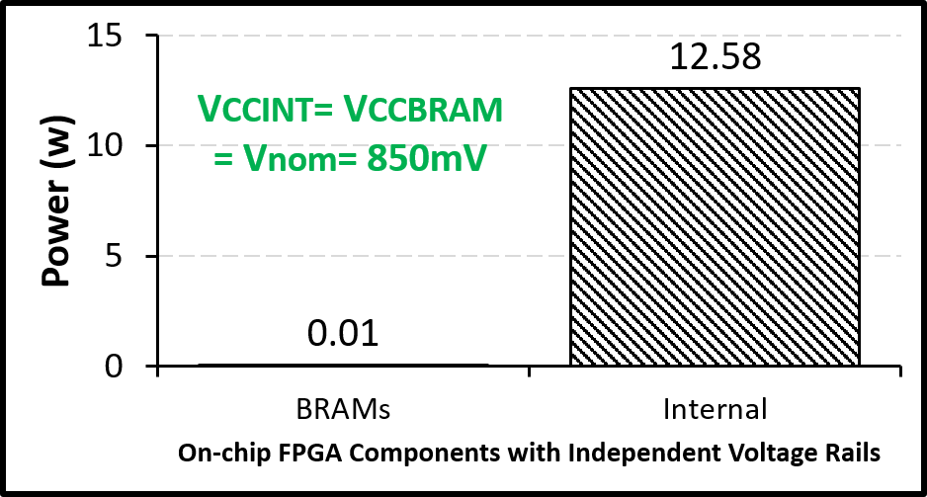
Power Breakdown
Observation: ~99% of the total power is consumed by internal components of the FPGA. (VCCint)

Slide 27
Power Breakdown
Observation: ~99% of the total power is consumed by internal components of the FPGA. (VCCint)
VCCint shares voltage with internal components of the FPGA’s which are DSPs, LUTs and buffers.

Slide 28
Power Breakdown
Observation: ~99% of the total power is consumed by internal components of the FPGA. (VCCint)
VCCint shares voltage with internal components of the FPGA’s which are DSPs, LUTs and buffers.
The rest of the analysis is based on the VCCint in terms of undervolting.

Slide 29
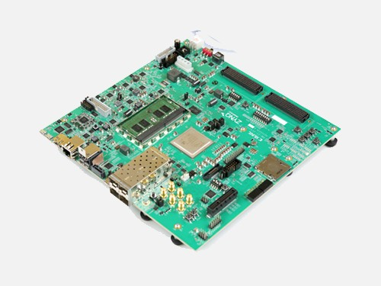
Demo Methodology
Xilinx ZCU102

Slide 30

Demo Methodology
Xilinx ZCU102
DNNDK
Petalinux

Slide 31
Demo Methodology
Regulate Voltage (PMBus API)
Xilinx ZCU102
DNNDK
Petalinux

Slide 32
Demo Methodology
Regulate Voltage (PMBus API)
Start neural network inference (Bash)
Xilinx ZCU102
DNNDK
Petalinux

Slide 33
Demo Methodology
Regulate Voltage (PMBus API)
Start neural network inference (Bash)
Start logging VCCint consumption (PMBus API)
Xilinx ZCU102
DNNDK
Petalinux

Slide 34
Demo Methodology
Regulate Voltage (PMBus API)
Start neural network inference (Bash)
Start logging VCCint consumption (PMBus API)
Evaluate Accuracy (Python)
Xilinx ZCU102
DNNDK
Petalinux

Slide 35
Demo Methodology
Regulate Voltage (PMBus API)
Start neural network inference (Bash)
Start logging VCCint consumption (PMBus API)
Evaluate Accuracy (Python)
Xilinx ZCU102
DNNDK
Repeat for each voltage level
Petalinux

Slide 36
Observations
Result-1: Voltage behaviour.

Slide 37
Observations
Result-1: Voltage behaviour.
Empirically analyze the guardband and voltage regions of the FPGA.

Slide 38
Observations
Result-1: Voltage behaviour.
Empirically analyze the guardband and voltage regions of the FPGA.
Result-2: Power and Reliability trade-off.

Slide 39
Observations
Result-1: Voltage behaviour.
Empirically analyze the guardband and voltage regions of the FPGA.
Result-2: Power and Reliability trade-off.
Correlation between accuracy loss and energy saving.

Slide 40
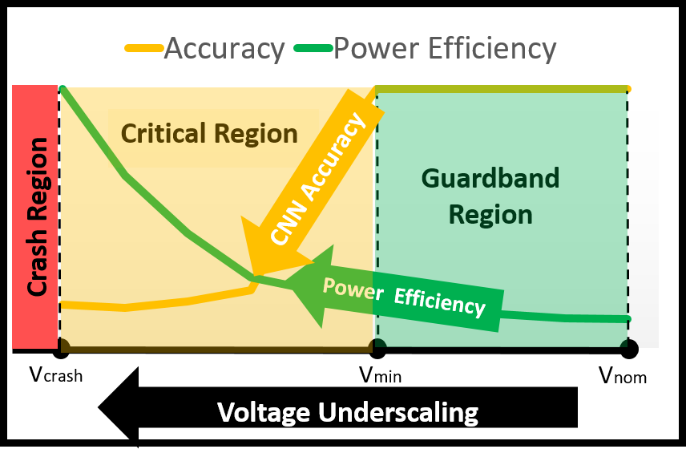
Voltage Behaviour

Slide 41
Voltage Behaviour
Safe guardband: ~33% of the nominal supply voltage can be eliminated without reliability issues. (850-570mV)
Added by manufacturers to ensure correct operation under worst-case environment.
~33% of the nominal voltage

Slide 42
Voltage Behaviour
Safe guardband: ~33% of the nominal supply voltage can be eliminated without reliability issues. (850-570mV)
Added by manufacturers to ensure correct operation under worst-case environment.
Critical Region: Supply voltage can be reduced further more to achieve an additional 43% power saving with reliability issues. (570-540mV)
totally ~43% of the nominal voltage
~33% of the nominal voltage

Slide 43
Voltage Behaviour
Safe guardband: ~33% of the nominal supply voltage can be eliminated without reliability issues. (850-570mV)
Added by manufacturers to ensure correct operation under worst-case environment.
Critical Region: Supply voltage can be reduced further more to achieve an additional 43% power saving with reliability issues. (570-540mV)
Crash Region: The FPGA stops operating. (below 540mV)
totally ~43% of the nominal voltage
~33% of the nominal voltage

Slide 44
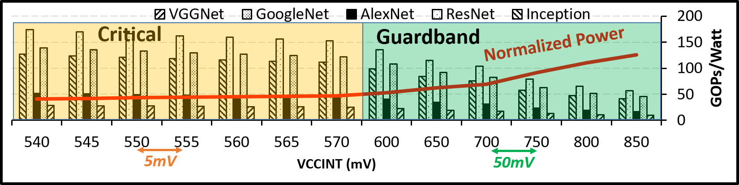
Power and Reliability Trade-off

Slide 45
Power and Reliability Trade-off
Power efficiency: More than 3x GOPs/W power efficiency gain.

Slide 46
Power and Reliability Trade-off
2.6x GOPs/W
Power efficiency: More than 3x GOPs/W power efficiency gain.
2.6x GOPs/W is gained by eliminating guardband.

Slide 47
Power and Reliability Trade-off
2.6x GOPs/W
Power efficiency: More than 3x GOPs/W power efficiency gain.
2.6x GOPs/W is gained by eliminating guardband.
Slight variation between workloads and FPGA platforms.

Slide 48
Power and Reliability Trade-off
Reliability overhead: CNN accuracy loss occurs when undervolting in the critical voltage region.

Slide 49
Power and Reliability Trade-off
Accuracy loss occurs
Reliability overhead: CNN accuracy loss occurs when undervolting in the critical voltage region.
Crucial accuracy collapse.

Slide 50
Power and Reliability Trade-off
Accuracy loss occurs
Reliability overhead: CNN accuracy loss occurs when undervolting in the critical voltage region.
Crucial accuracy collapse.
Slight variation between workloads and FPGA platforms.

Slide 51
Power and Reliability Trade-off
Accuracy loss occurs
Reliability overhead: CNN accuracy loss occurs when undervolting in the critical voltage region.
Crucial accuracy collapse.
Slight variation between workloads and FPGA platforms.

Slide 52
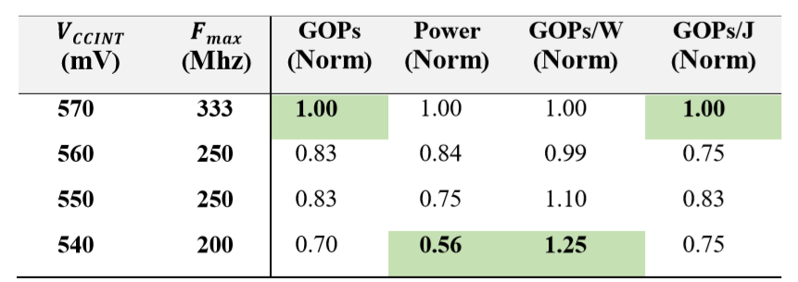
Frequency Underscaling

Slide 53
Frequency Underscaling
Find Fmax for the specified voltage that system runs with no accuracy loss.

Slide 54
Frequency Underscaling
Find Fmax for the specified voltage that system runs with no accuracy loss.
Reducing frequency keeps system reliable with the cost of performance and energy efficiency loss.

Slide 55
Frequency Underscaling
Optimum setting for high performance and high energy efficiency.

Slide 56
Frequency Underscaling
Optimum setting for high performance and high energy efficiency.
GOPs and GOPs/J are maximized.

Slide 57
Frequency Underscaling
Optimum setting for power efficiency.

Slide 58
Frequency Underscaling
Optimum setting for power efficiency.
Power is minimized.
GOPs/W is maximized.

Slide 59
Related Works
Undervolting studies for the off-the-shelf CPUs, GPUs,
ASICs (GreenTPU-DAC19’), DRAMs (EDEN-MICRO19’).
Large guardbands are common and vary from 12%-35% off the nominal supply voltage.
Power efficient neural network studies with architectural, Hardware, Software techniques.
Reliable neural network studies with analytical(Thundervolt-DAC18’) and simulation based techniques.

Slide 60
Summary and Conclusion

Slide 61
Summary and Conclusion
Summary:
Our study confirms the existence of large guardbands for FPGAs.

Slide 62
Summary and Conclusion
Summary:
Our study confirms the existence of large guardbands for FPGAs.
We propose a hardware level technique that enables more than 3x power efficiency.

Slide 63
Summary and Conclusion
Summary:
Our study confirms the existence of large guardbands for FPGAs.
We propose a hardware level technique that enables more than 3x power efficiency.
2.6x power saving from eliminating guardband. (without accuracy loss)

Slide 64
Summary and Conclusion
Summary:
Our study confirms the existence of large guardbands for FPGAs.
We propose a hardware level technique that enables more than 3x power efficiency.
2.6x power saving from eliminating guardband. (without accuracy loss)
Further power savings are possible with the cost of

Slide 65
Summary and Conclusion
Summary:
Our study confirms the existence of large guardbands for FPGAs.
We propose a hardware level technique that enables more than 3x power efficiency.
2.6x power saving from eliminating guardband. (without accuracy loss)
Further power savings are possible with the cost of
Accuracy loss. (frequency is not underscaled)

Slide 66
Summary and Conclusion
Summary:
Our study confirms the existence of large guardbands for FPGAs.
We propose a hardware level technique that enables more than 3x power efficiency.
2.6x power saving from eliminating guardband. (without accuracy loss)
Further power savings are possible with the cost of
Accuracy loss. (frequency is not underscaled)
Performance loss. (frequency is underscaled)

Slide 67
Summary and Conclusion
Summary:
Our study confirms the existence of large guardbands for FPGAs.
We propose a hardware level technique that enables more than 3x power efficiency.
2.6x power saving from eliminating guardband. (without accuracy loss)
Further power savings are possible with the cost of
Accuracy loss. (frequency is not underscaled)
Performance loss. (frequency is underscaled)
Conclusion:

Slide 68
Summary and Conclusion
Summary:
Our study confirms the existence of large guardbands for FPGAs.
We propose a hardware level technique that enables more than 3x power efficiency.
2.6x power saving from eliminating guardband. (without accuracy loss)
Further power savings are possible with the cost of
Accuracy loss. (frequency is not underscaled)
Performance loss. (frequency is underscaled)
Conclusion:
Undervolting is a promising technique to achieve significant power saving for FPGA based neural network accelerators.

Slide 69
Q & A

Slide 70
Özkütle Deneyi
Demonstrating Reduced-Voltage FPGA-Based Neural Network Acceleration for Power-Efficiency
Erhan Baturay Onural
TOBB ETU
Ismail Emir Yuksel
TOBB ETU
Behzad Salami
BSC
Main Paper:
https://www.researchgate.net/publication/343353269_An_Experimental_Study_of_Reduced-Voltage_Operation_in_Modern_FPGAs_for_Neural_Network_Acceleration

